Slide 1
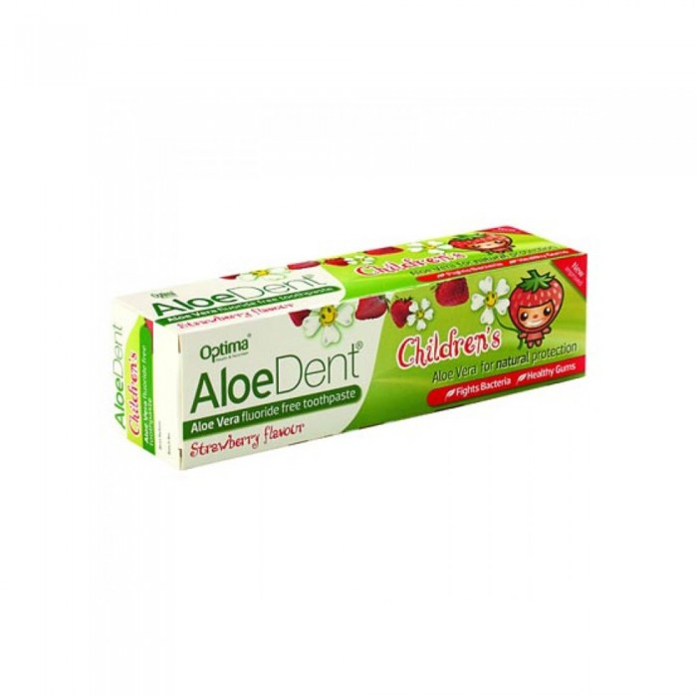
Alu Dent Toothpaste For Strawberry Children 50ml
17.47 SAR. Q
AloeDent toothpaste for fluoride-free babies. We have added some of nature's most trusted ingredients to our formulations. Including soothing aloe vera along with tea tree oil, which is a natural disinfectant. So you can make sure your child gets all the benefits of fluoride-free toothpaste

Slide 2
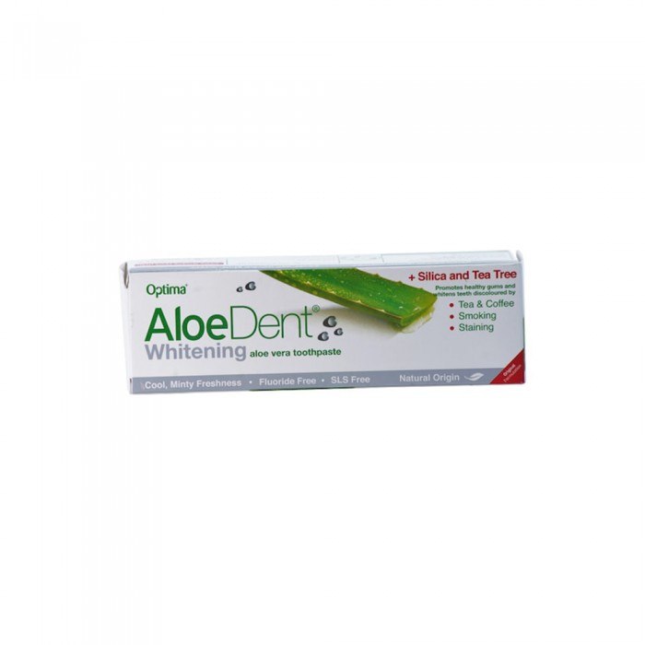
Ovarian Dental Toothpaste 50ml
18.56 SAR. Q
- The ovarian daunt toothpaste is characterized by a wonderful natural mint flavor.
- Promotes gum health and works on whitening teeth that change colour through tea, coffee and smoking.

Slide 3
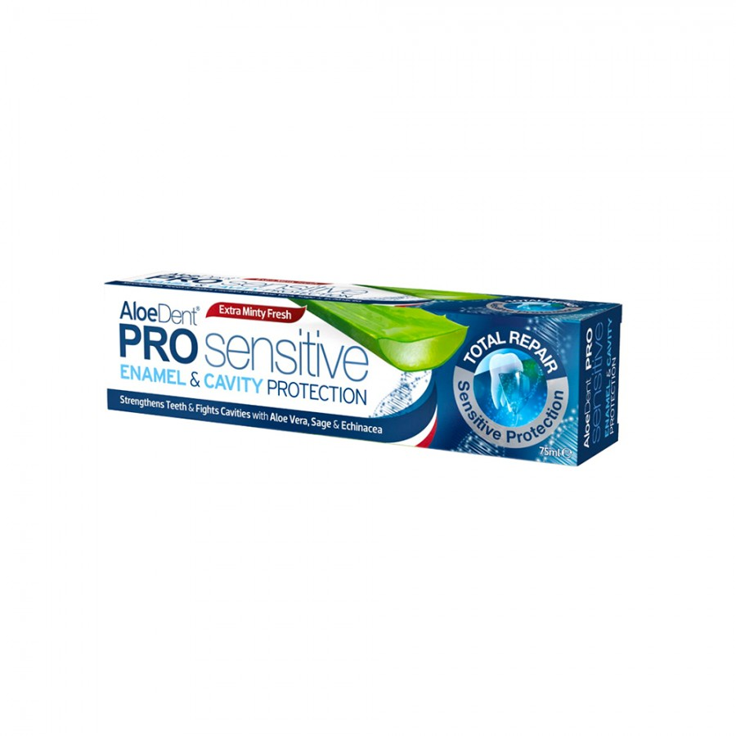
Toothpaste Waddent Prosence Enamel Protector 75 ml
30.12 SAR. Q
Invest in your smile with enamel and cavity protection. Aloe vera toothpaste with advanced protection from cavities and defense of maximum sensitivity. This original toothpaste contains a combination of natural enamel strengthening ingredients with additional protection from scientifically balanced fluoride and potassium salts, which helps to restore metal hardness, reduces dental hypersensitivity, refreshes breathing and prevents stains caused by daily contaminants such as tea, coffee and red wine

Slide 4
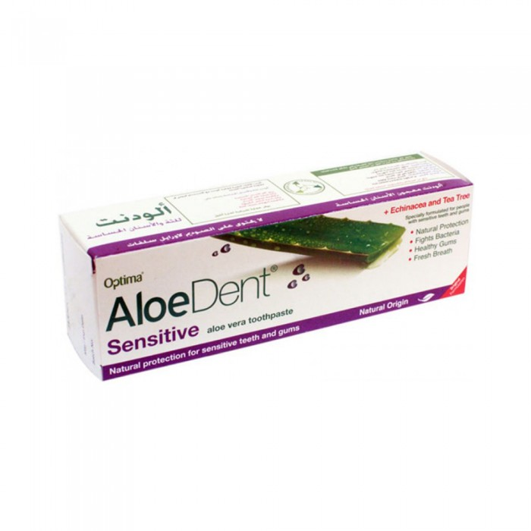
Waddent Toothpaste for Sensitive Teeth 50 ml
18.56 SAR. Q
- Waddent toothpaste for sensitive teeth helps to remove and prevent stains
- Refresh and whiten the teeth by gently removing the surface stains
- Fighting germs for 12 hours
- Refreshes breathing and helps prevent plaque and gum inflammation.

Slide 5
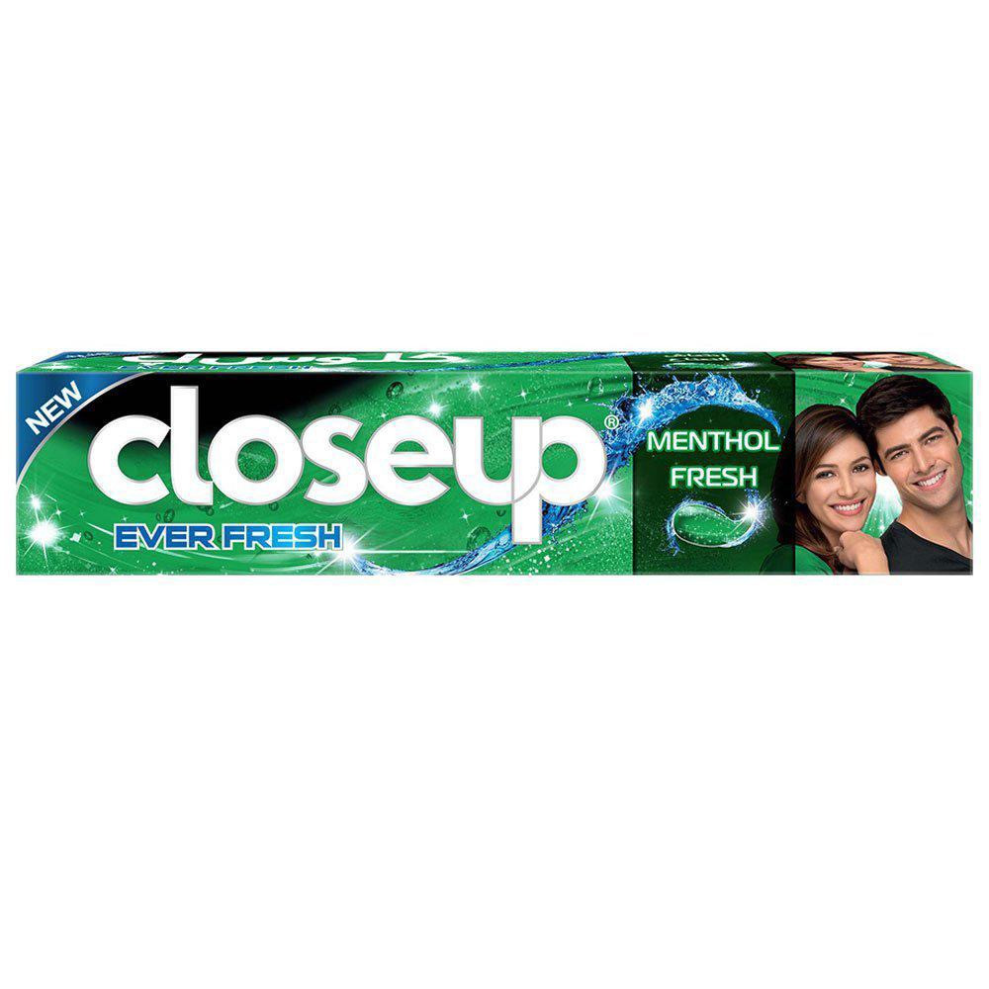
Closs Father Toothpaste Fragrant Mint Refreshing 50ml
6.90 SAR. Q
It is made of active zinc mouth lotion and small polishing crystals for bright teeth and white teeth. Cleans teeth, and provides a refreshing breath for longer.

